Slide 1
Tableau Project – Causes of Death
Presented by Johnathan Jack

Slide 2
Project flow
Determine what kind of data was present
Categorized the data types
Look for correlations with date and all types of death
Look for interesting trends through line charts and investigate
Research world events at specific years of interest
Create dashboards to be used in a story

Slide 3
Main questions
What is the main cause of death?
Is there a difference between health related and non-health related deaths?
Will it still be increasing in the future?
Where are these deaths occurring?
Is it the main factor in all countries?

Slide 4

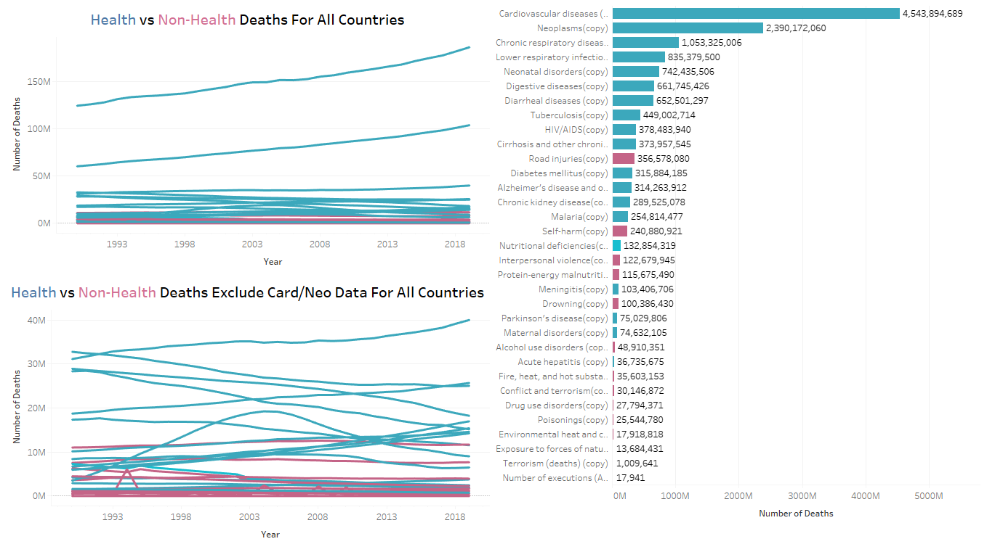
What is the main cause of death
Cardiovascular diseases and neoplasms(cancer) are the leading causes of death. The line graph showcases their influence over time and the bar plot is the sum throughout 1990-2019

Slide 5
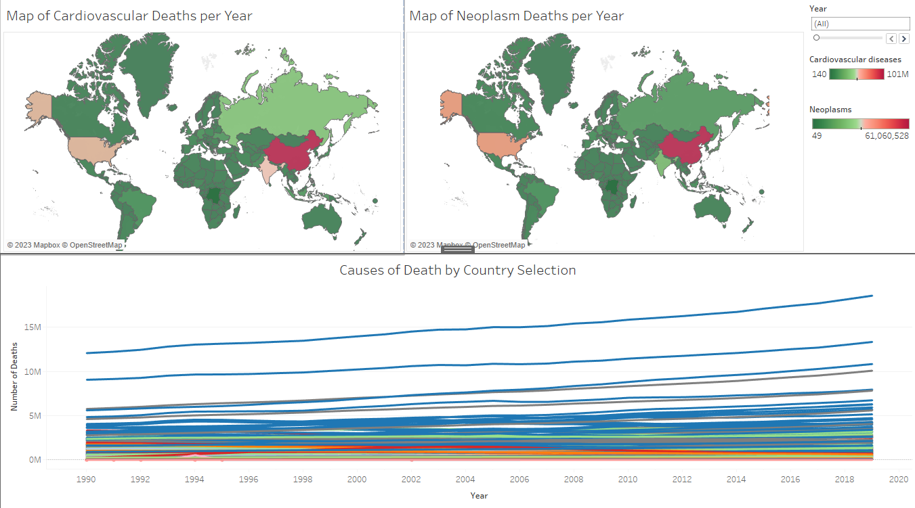
Where are these deaths occurring
The maps show where the majority of deaths for cardiovascular and neoplasms deaths are located. A year slider can be used to show each year's progression from 1990-2019. Clicking on a country in either map will highlight each country’s cause of death in the line graph below. Hovering over the lines will provide the cause of death.

Slide 6
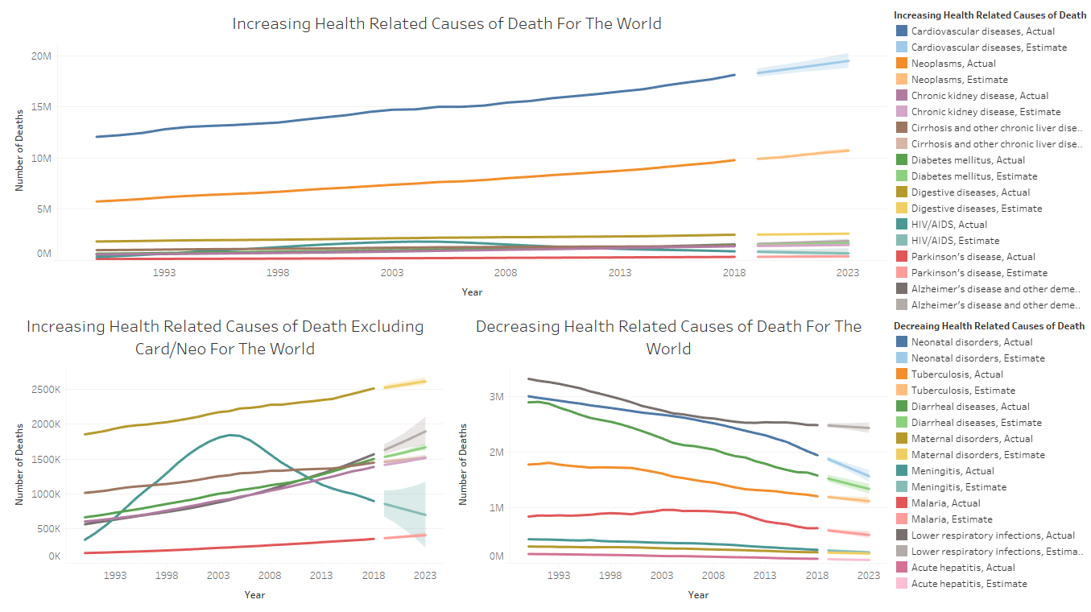
Trends for causes of death
The line graphs indicate the current trends for each health-related causes of death. The highlighted portions are future projections of each variable.
HIV is interesting as it increased and peaked during 2004 and is now slowly decreasing.
Understanding the disease and spreading knowledge of its mode of transmission key in declining trend
Introduction of Antiretroviral therapy programs

Slide 7
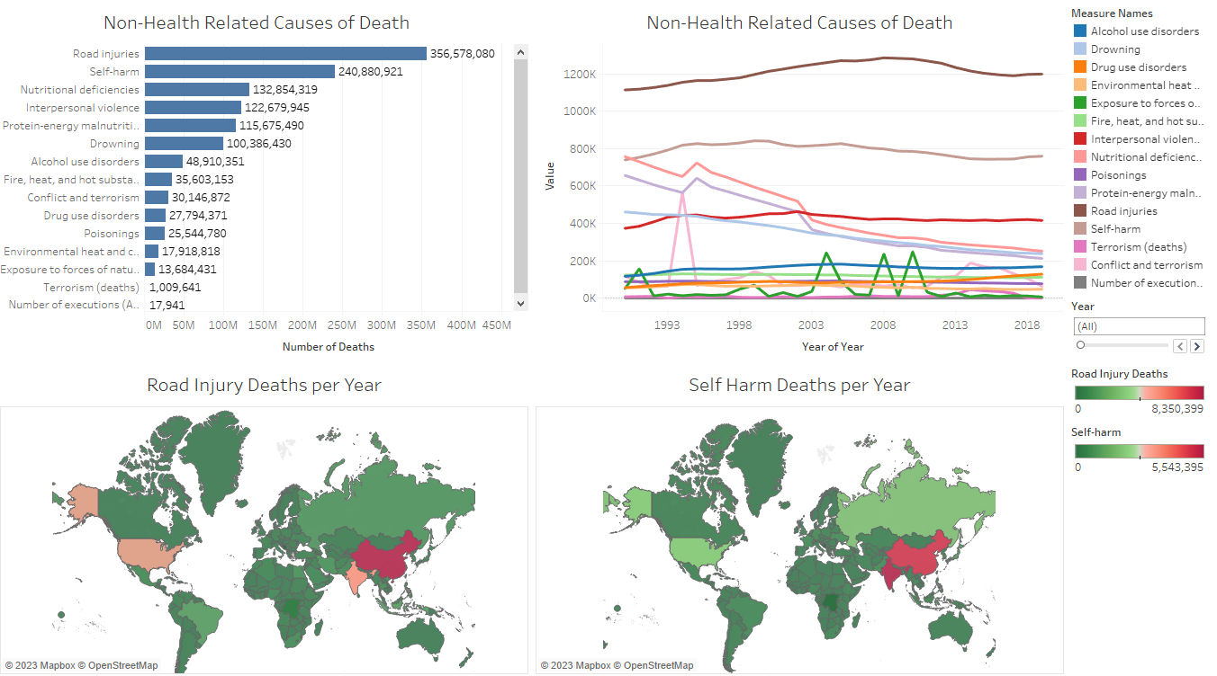
Trends for causes of death
Highest non-related death is mainly contributed by road injuries and self-harm.
Interesting trends:
Conflict and Terrorism spiking during 1994 and 2014
Rwanda genocide (1994)
Syrian war (2011-2018) with Iraq war in 2014
Exposure to Nature during 1991, 2004, 2008, 2010
Bangladesh cyclone (1991)
Indian ocean earthquake and tsunami in Asia (2004)
Cyclone nargis in Myanmar (2008)
Haiti earthquake(2010)

Slide 8
Biggest challenges/Future goals
Although some trends are increasing, it is unknown if it is truly increasing without taking in account of the total population at each year
Some diseases may be more common in certain genders than others
Age is not given but it plays a huge role in understanding the effect of each diseases
Trying to get visualizations that were not line graphs
Difficult to portray other types of visualizations as this data is mainly focussed on trends for the countries in the world

